Slide 1


UNICART A MEDIA BAZAAR SOLUTION
Here is where your presentation begins

Slide 2
TABLE OF CONTENTS
01
02
03
WHO ARE WE?
THE PROBLEMS
THE SOLUTIONS
04
05
WHY OUR PRODUCT?
WORKFLOW
Meet the team
Tackling the hurdles
Paths to overcome challenges
The benefits of our solution
Streamlining processes and gaining insights

Slide 3


01
WHO ARE WE?

Slide 4
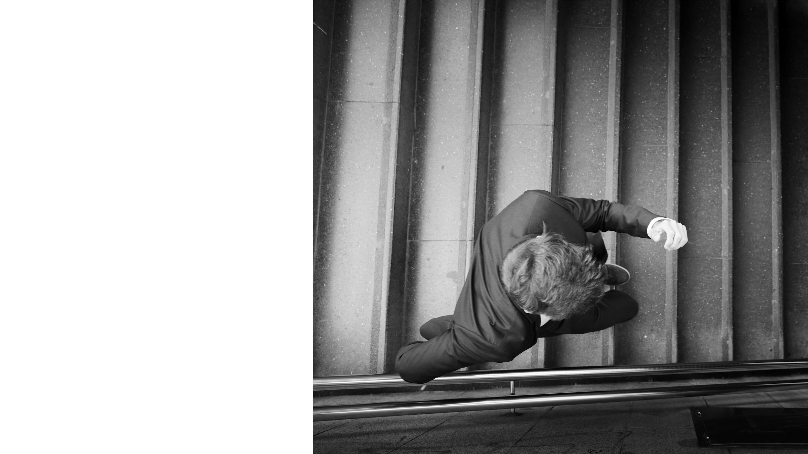
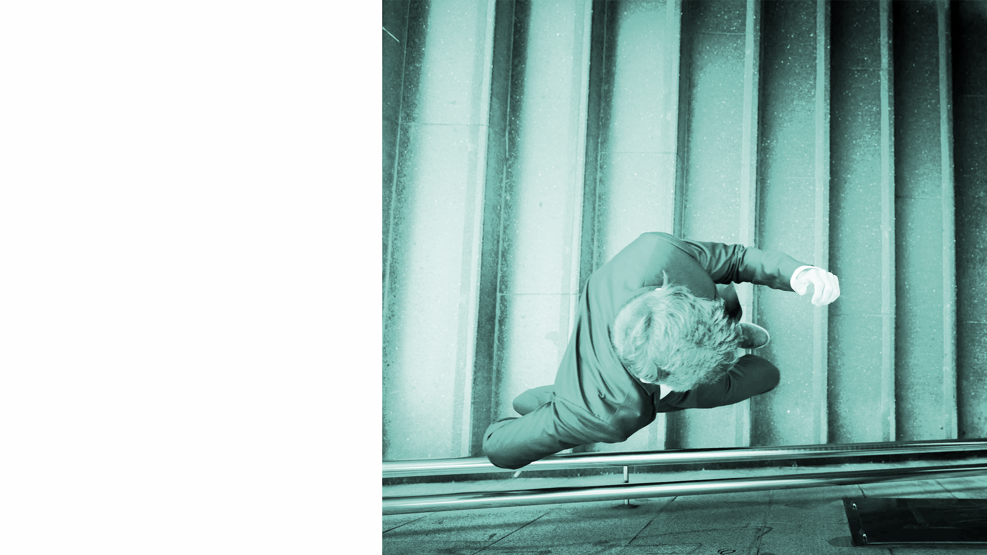
LET’S DIVE IN!
At UNICART, we thrive on effective communication and teamwork. Our commitment to staying connected, both during our university days and on Discord, has been key to our success. This enables us to efficiently allocate tasks, with each member contributing significantly to our shared goals. Join us as we champion collaboration and innovation on our journey to success.

Slide 5
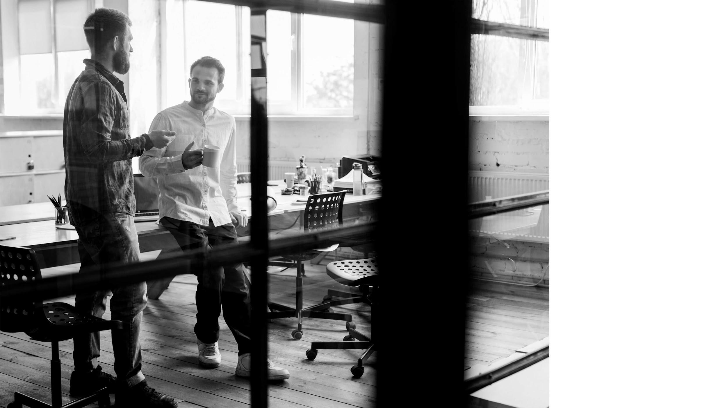

02
THE PROBLEMS

Slide 6

IN DEPTH
CLIENT
Media Bazaar's management is seeking to recruit a team of software developers. Their primary concern is effectively monitoring both employees and products.
Furthermore, the system should enable users to assign work shifts to employees and offer a user-friendly interface for tracking these shifts at both individual and store-wide levels.

Slide 7


03
THE SOLUTIONS

Slide 8
SOLUTIONS
SHIFT SCHEDULING
INVENTORY MONITORING
STOCK ALERT
SHIFT TRACKING
Develop an app for admins to easily manage employee shifts, assignments, and removals.
Create a web app for employees to check real-time stock levels and request restocking when needed.
Create a tool that alerts employees when product stock is low, ensuring timely restocking.
Create an app that tracks and generates reports on employee shifts, aiding in efficient workforce management.

Slide 9


04
WHY OUR PRODUCT?

Slide 10
THE BENEFITS
Improved Visibility
Gain insights into your operations with our product's detailed reporting.
Scalability
Seamless Collaboration
Our product grows with your needs, adapting to your evolving requirements.
Foster teamwork and coordination with our intuitive interface.
Enhanced Efficiency
Our product streamlines processes, saving you time and resources.
Cost Savings
Reduce expenses and optimize your budget using our solution.

Slide 11


05
WORKFLOW

Slide 12

THE PROCESS
We transitioned from the Waterfall methodology, where we followed a sequential approach starting with comprehensive design documentation, to the Agile Method. In Agile, we embraced iterative development, allowing us to submit weekly iterations and adapt our project dynamically to changing requirements and user feedback.

Slide 13


THANKS
Does anyone have any questions?

